Slide 1
Design Efficacy Measurement (DEM) Phase 1. Exploratory data analysis Amir Sajjadi 03.31.2025
Data are modified for the confidentiality purpose!
Notes:
First step towards analyzing data and creating the predictive models

Slide 2
Summary
Introduce a new methodology; Design Efficacy Measurement (DEM) tool
How DEM is developed and what are the relevant metrices
How it can be used to monitor treatment progression quantitatively
How it can enhance the product performance and reduce DE rates during the treatment
Overall roadmap to create a treatment predictability model

Slide 3
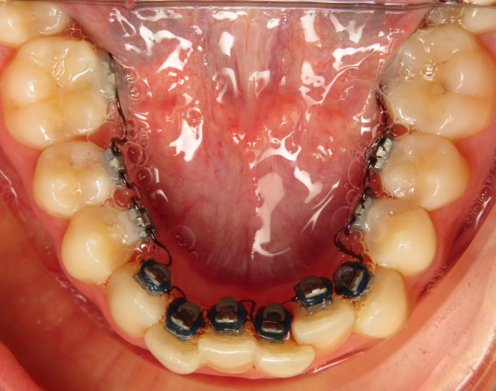
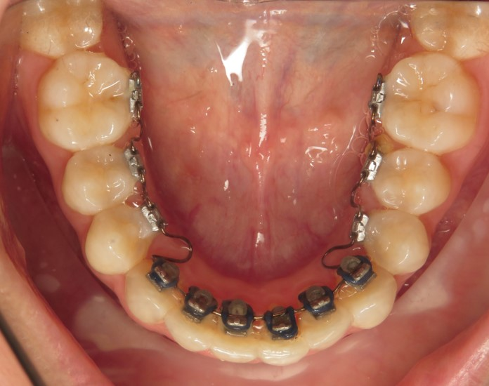
Develop Design Efficacy Measurement (DEM) Methodology
Objective:
Create a Design Efficacy Measurement tool or metrices to measure or/and predict treatment outcome based on design input.
Treatment goals: Moving teeth to an ideal teeth arch/location
Study Goals: To quantitatively measure the teeth movements between Initial case and the case outcome at the time of DE and compare with expected design movements
How: To calculate the Pairwise Bracket Movements between Initial case and the outcome at the time of DE
Malocclusion | Ideal
Malocclusion | Malocclusion DE

Slide 4
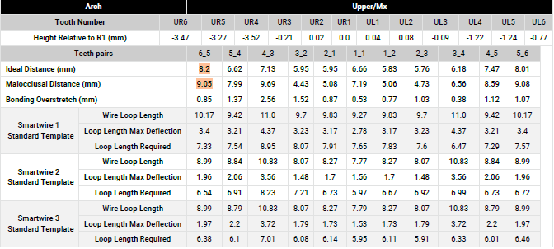
Difference Between Clinical and Design (mm)
Difference Between Clinical and Design = (Expected Design) – (Clinical Outcome)
OR
Difference Between Clinical and Design =
|(Initial (Malocclusion) Bracket Distances – Ideal Bracket Distances)|
– |(Initial (Malocclusion) Bracket Distances - Malocclusion-DE Bracket Distances)|
EQC840
EQC840-DE

Slide 5
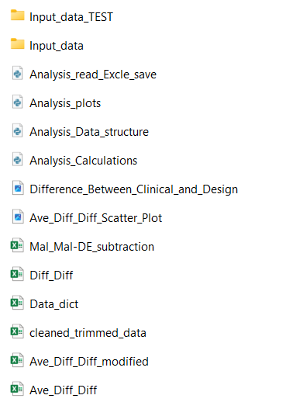
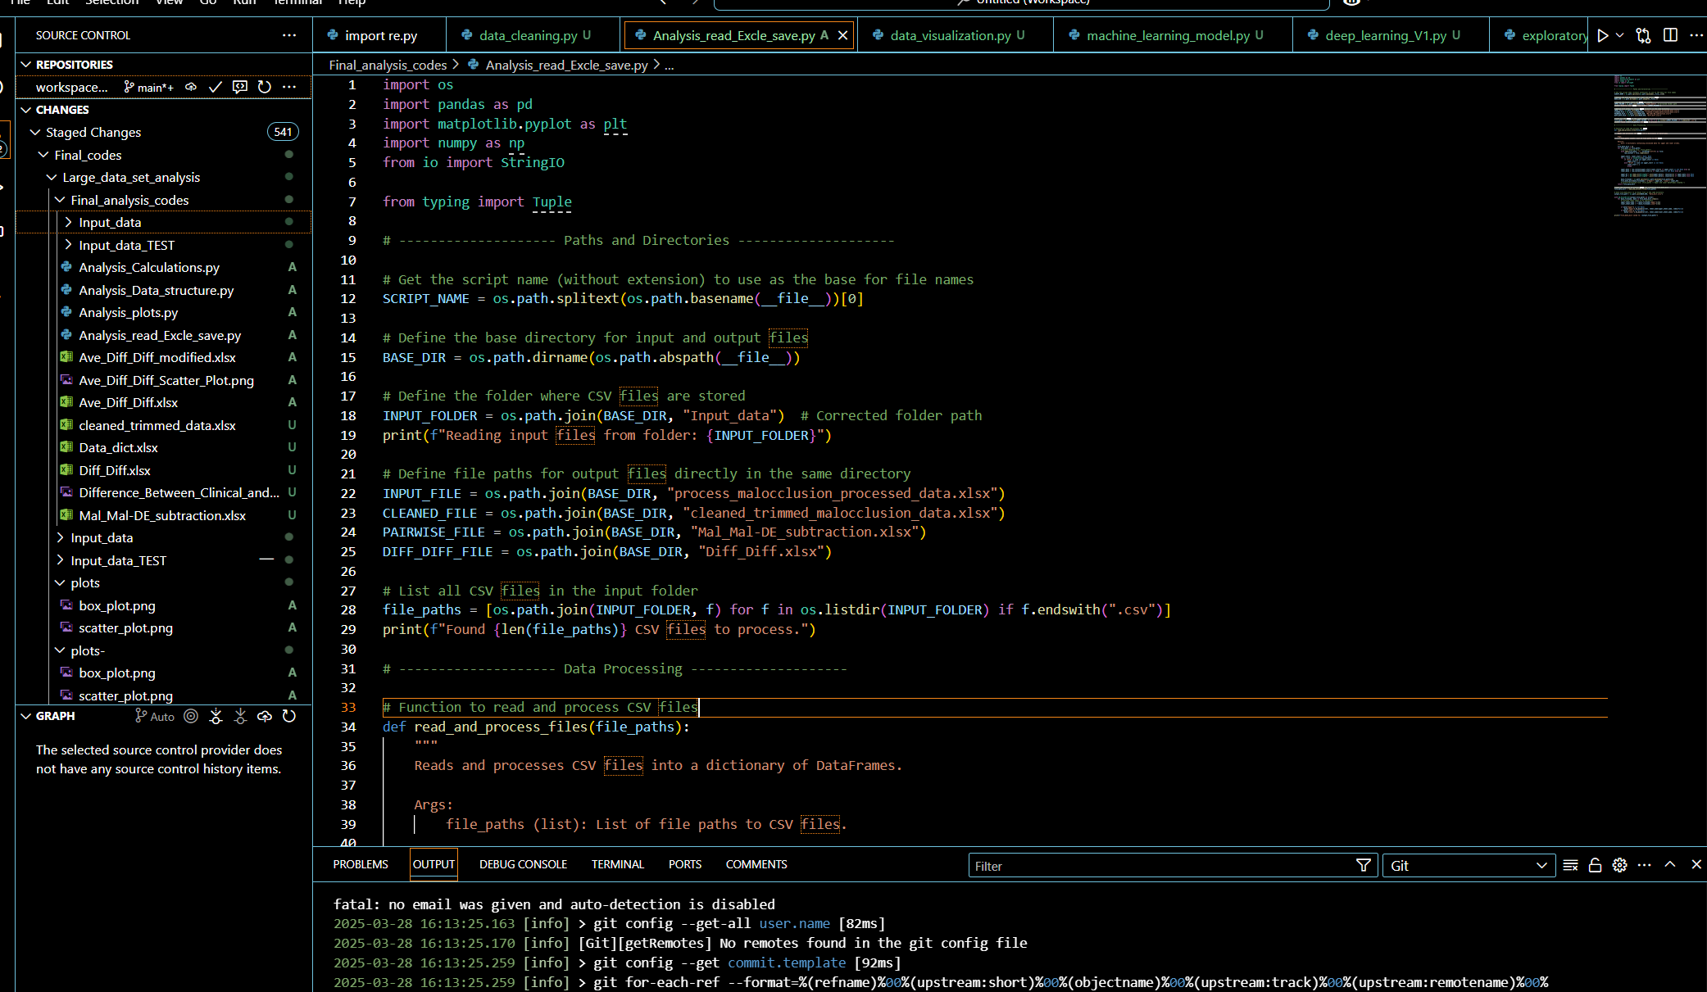
Python Codes and Data Analysis for 50 patients

Slide 6
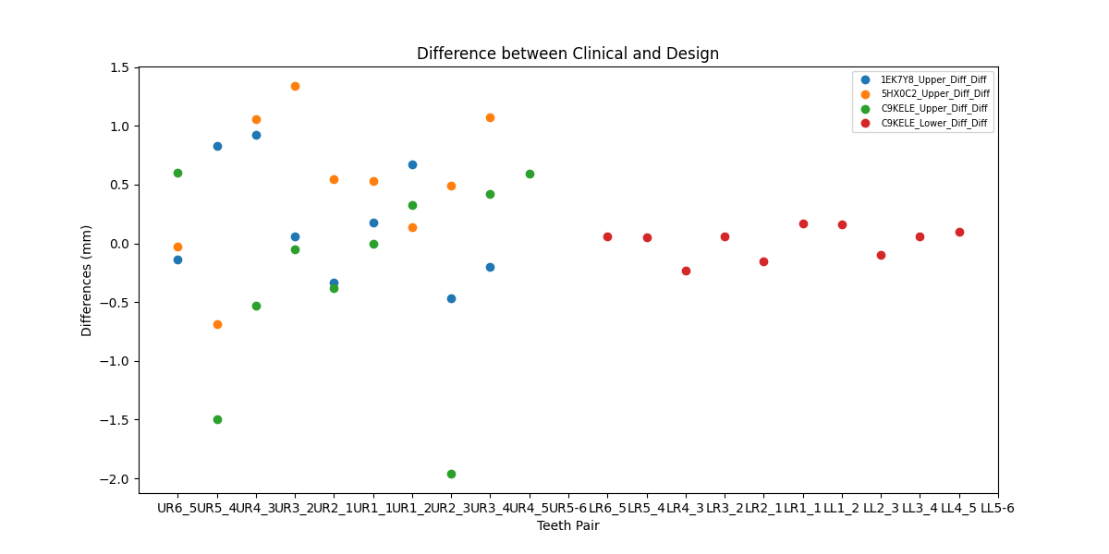
Monitoring Clinical Progression (individual patient’s data)
DEM Line
DEM Line
Predictive Metric
Upper Teeth
Lower Teeth
Notes:
DEM lines are predictor metrices, providing a range that the can tell if the treatment is progressive or being deviated from the expected plan!

Slide 7
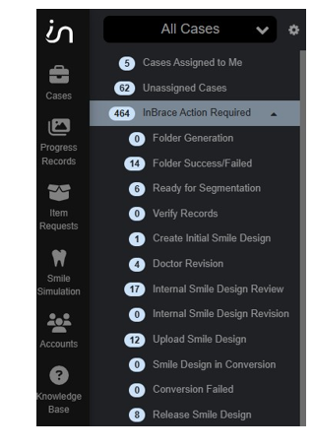
Predictive Metric
Quantitative tool to reduce the cycle time by automating the clinical assessment and early monitoring the clinical output
Help in detecting Early and False DEs
Provides statistical data to monitor the progression and efficacy of treatment process during multiple DEs
Longer vision: To enhance the design process by finding correlation between design rules, IFS, etc.

Slide 8
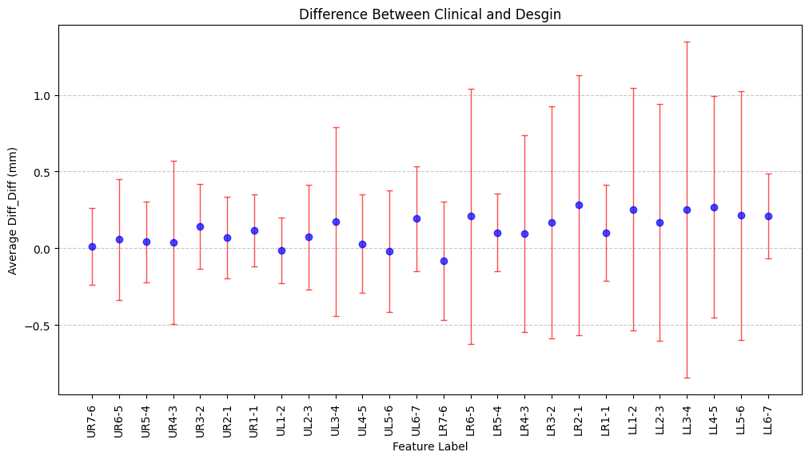
Product Performance Enhancement (50 patients)
DEM Line
DEM Line
Upper
Lower

Slide 9
Analysis
DEM predictor can be utilized for each patient to evaluate the treatment progression.
A quantitative tool to enhance the decisions on DE implementation timeline, SW timeline or further analysis of the patient treatment plan.
How can we integrate with clinical input (qualitative input)?
How can we implement; as an app or in the software?
Questions:
Can we find correlations between different metrics over large set of data and define a universal predictor model to design more effectively?
How can we implement the predictor model to monitor the treatment outcome using scan data from devices like cellphone camera app (e.g. Grin scope) in near future?

Slide 10
Treatment Predictability and AI Model
Design Efficacy Metric (DEM Tool)
Explore correlations in data, e.g. IFS, Design Rules, clinical output etc.
Develop Predictive Models
Apply Models and ML to improve the design
Analysis next steps:
To create a pipeline to analyze a large set of cases (1000 patients):
Restructure the analysis methodology to address this number of patients’ analysis
Update and develop the code and analysis methodology
Utilize quantitative and qualitative metrics to analyze the outcome
Validating the process
Reviewing the results
Recommendations and final implementations

Slide 11
Thank you

Slide 12
DEM Proposal Brief
Initiated by: | Amir Sajjadi
Problem statement: | How to reduce DE rate by calculating treatment outcome efficacy.
Proposed Solution | To calculate and compare the Pairwise Bracket Movements between Initial case and the Outcome at the time of DE and develop relevant predictive metrices.
Objective | Develop a Design Efficacy Measurement (DEM) tool to measure or predict treatment outcome based on the design input.

Slide 13
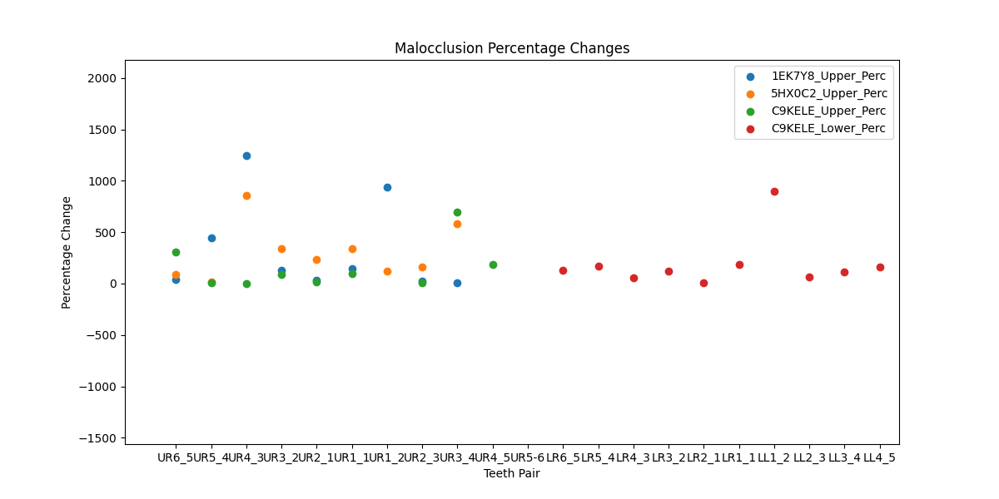

Slide 14
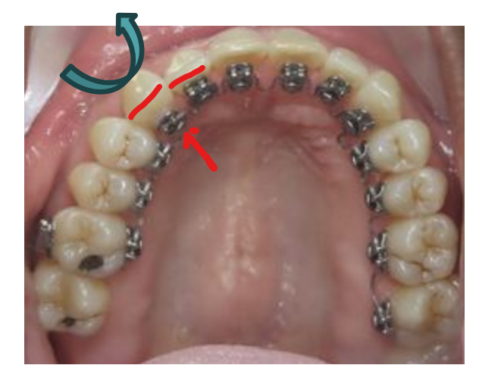
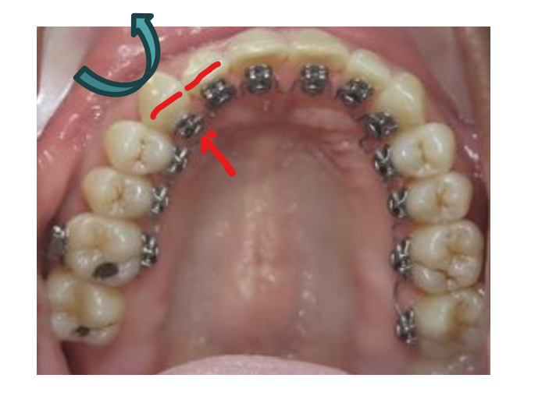
Additional Analysis with markers

Slide 16
